Slide 1
ACCIDENT DETECTION
NAME:
1)S.Mohamed Nasrutheen
2) S.Morton Rillo
3)A.Naveen
NAME: REGISTER NO.: PAGE NO: 08
SRR/CSE/MINI PROJECT/REVIEW2

Slide 2
OVERVIEW OF THE PROJECT
Abstract
Existing System
Disadvantages of the Existing system.
Proposed System
Data flow Diagram/Architectural diagram/Block diagram
Modules and Brief Description
Application of the proposed work
Conclusion
Future Enhancement
References (IEEE format)
NAME: REGISTER NO.: PAGE NO: 08
SRR/CSE/MINI PROJECT/REVIEW2

Slide 3
ABSTRACT
As the usage of vehicles is increasing drastically, the hazards due to vehicles is also increased.
The main cause for accidents is high speed, drunk and drive, diverting minds, over stress and due to electronic gadgets.
After the accident has occurred there will be less chance of people surround us at the time and if we are in unconscious, this project will be works at the time.
Vibrating sensor will detect the accident and send the information to the to ardiuno will command the GPS to sense the location to registered mobile number.
Finally the accident will be recovered very quickly and this will reduce the chance of critical issues of accident.
NAME: REGISTER NO.: PAGE NO: 08
SRR/CSE/MINI PROJECT/REVIEW2

Slide 4
EXISTING SYSTEM
The injured person will call the ambulance service if the accident has occurred.
Near people will only able to contact the ambulance if the person can’t call the ambulance due to severe injured and go to the unconscious state.
The injured person or near people should find the to location of the accident to inform the ambulance service.
Injured person should contact the relatives to inform about the accident occurred.
NAME: REGISTER NO.: PAGE NO: 08
SRR/CSE/MINI PROJECT/REVIEW2

Slide 5
DEMERITS OF EXISTING SYSTEM
The injured person should inform about the accident to the ambulance service.
The person can’t call the ambulance due to severe injured and go to the unconscious state , nearer people will only able to contact the ambulance.
The injured person or the people nearer will find difficult to locate the accident occurred to inform the ambulance service.
Doctors will face the difficult to inform the relatives about the accident if he gone to the unconscious state.
NAME: REGISTER NO.: PAGE NO: 08
SRR/CSE/MINI PROJECT/REVIEW2

Slide 6
PROPOSED SYSTEM
The accident occurred will be founded with the help of SMS service automatically by vibrating sensor.
The message will be send to the registered mobile number when the accident have been occurred with help of GSM module.
The location of the accident will be sent along with the SMS service to the registered mobile number.
The registered person will coordinate the location to the ambulance service with the current situation of the accident by GPS sensor.
NAME: REGISTER NO.: PAGE NO: 08
SRR/CSE/MINI PROJECT/REVIEW2

Slide 7
PROPOSED SYSTEM-MERITS
Time taken to contact the ambulance will be lesser by the trusted person than the injured people.
The accident occurred will informed the relatives easily and by automatically.
Type of injury that have occurred to the person can identified easily to trusted person and ambulance service.
Current location of the accident will be shared to the registered mobile number and the ambulance service.
NAME: REGISTER NO.: PAGE NO: 08
SRR/CSE/MINI PROJECT/REVIEW2

Slide 8
SYSTEM SPECIFICATION
SOFTWARE REQUIRED
ARDUINO IDE
WINDOWS 7 OR MORE
HARDWARE REQUIRED
GSM MODULE
GPS MODULE
VIBRATING SENSOR
ARDIUNO UNO
CONNECTING WIRES
RYZEN 3 OR INTEL i3 PROCESSOR
RAM 2GB
NAME: REGISTER NO.: PAGE NO: 08
SRR/CSE/MINI PROJECT/REVIEW2

Slide 9
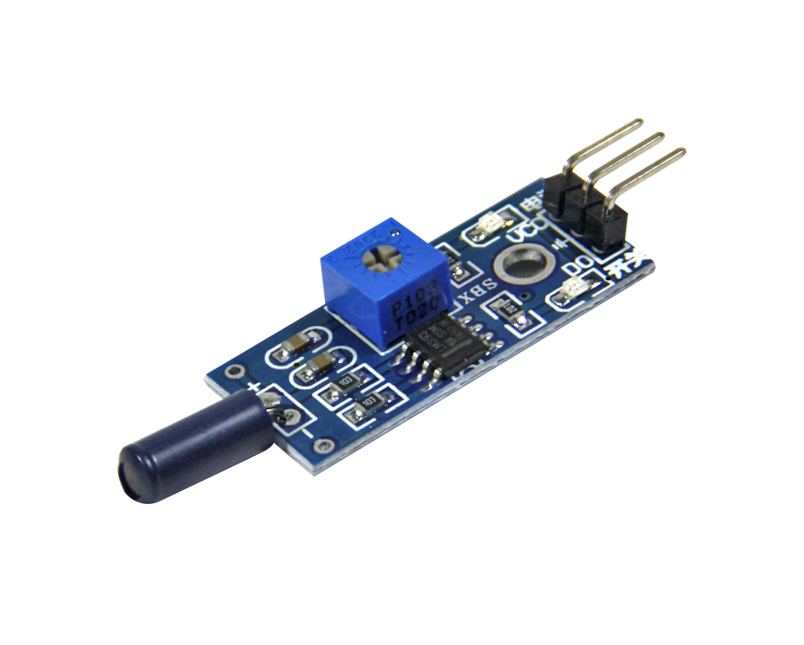
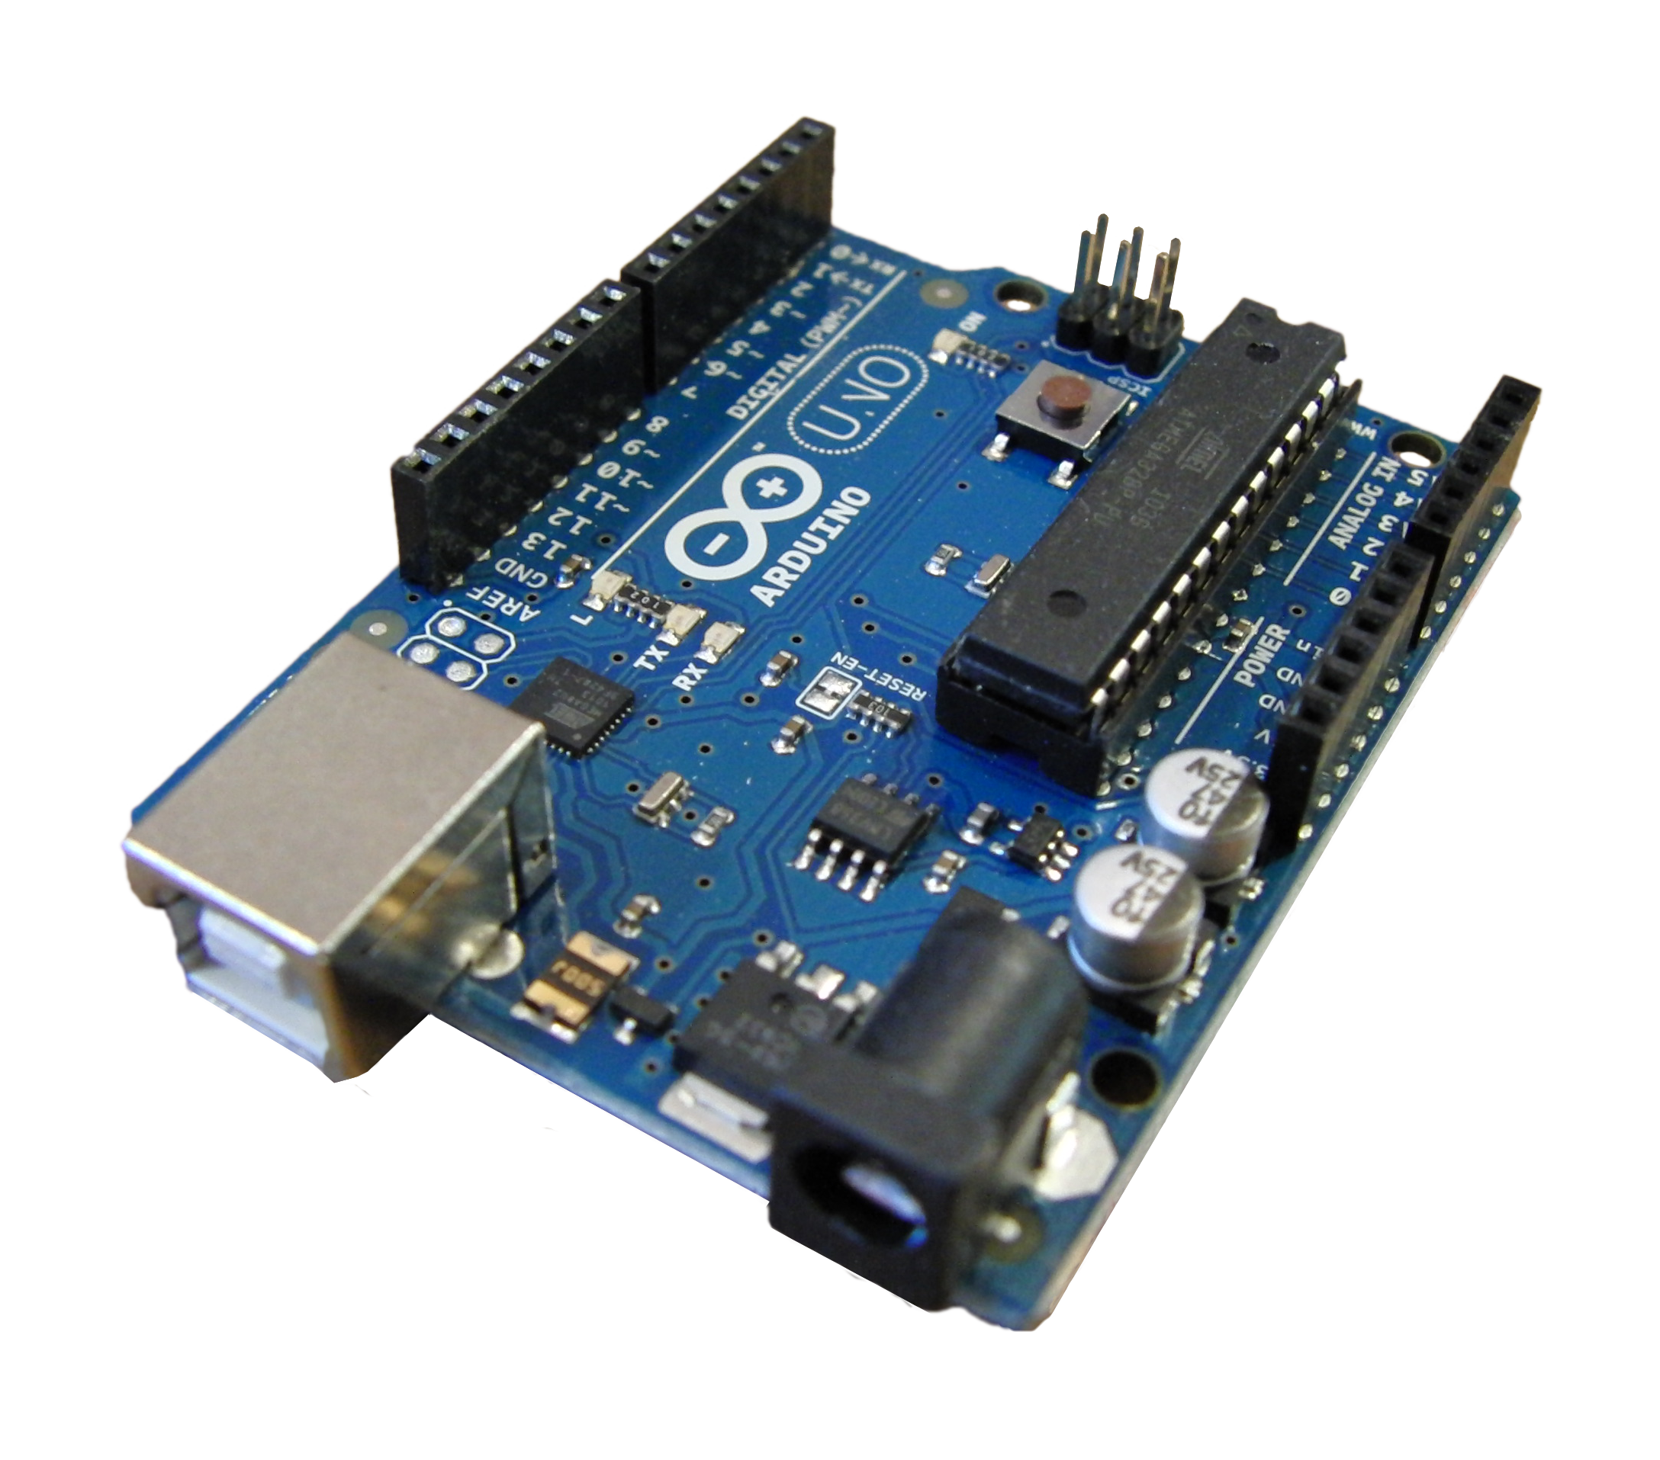
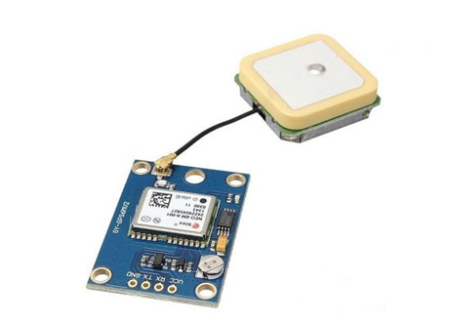
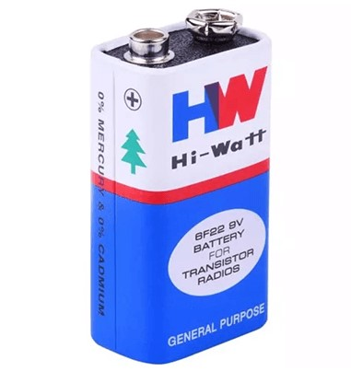

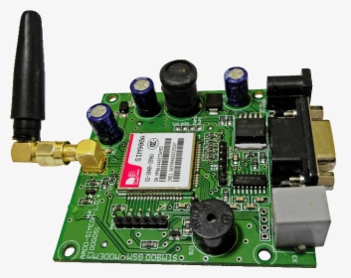
ARCHITECHTURE DIAGRAM
Arduino command GPS module to sense current location
Vibration signal to Arduino
Vibrating Sensor
GPS sends the location to the Arduino
Arduino UNO
GPS Sensor
Power Supply to Arduino
Arduino send location to GSM Module
Power Supply
GSM sends message and location via SMS to Registered Mobile
GSM Module
NAME: REGISTER NO.: PAGE NO: 08
SRR/CSE/MINI PROJECT/REVIEW2

Slide 10
LIST OF MODULES
Accident Happens and Sensor Detection :
When the collision occurs , the vibration the collision is detected.
Hardware Activation :
After vibrating signal action detection , the current location is gathered by GPS module and the will send to the GSM Module.
Message send :
The GSM module will send location to the registered mobile number.
NAME: REGISTER NO.: PAGE NO: 08
SRR/CSE/MINI PROJECT/REVIEW2

Slide 11
Module 1
In the module 1, we are going to see about the accident happens and how it is detected.
Vibrating Sensor
vibrating sensor means the device which is used to detect the sudden change in the physical state and measure the change.
Steps:
Here we use the vibrating sensor which detect the particular mechanical force by the accident.
This will find whether the accident is happened or not by the vibration in the sensor.
Then this accident information will be sent to the Arduino will receive the information and proceed steps.
NAME: REGISTER NO.: PAGE NO: 08
SRR/CSE/MINI PROJECT/REVIEW2

Slide 12
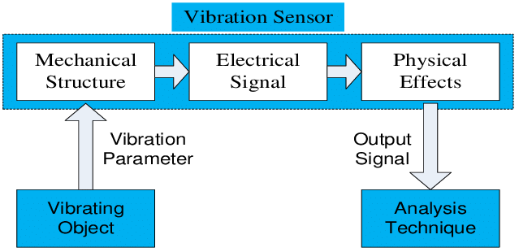
Module 1
Vibrating Sensor:
NAME: REGISTER NO.: PAGE NO: 08
SRR/CSE/MINI PROJECT/REVIEW2

Slide 13
Module 2
In the module 2, we are going to see about the location gathered by the GPS sensor and informing to the GSM module about the current location.
GPS Sensor
This GPS Sensor will detect the current location of the accident happened after the request given
Steps:
The arduino will send the command to the GPS sensor to Locate the current location.
The GPS sensor will locate the location of the accident and send to the Arduino.
The arduino will send the location to the GSM module.
NAME: REGISTER NO.: PAGE NO: 08
SRR/CSE/MINI PROJECT/REVIEW2

Slide 14
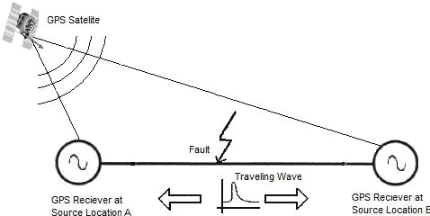
Module 2
GPS Sensor:
NAME: REGISTER NO.: PAGE NO: 08
SRR/CSE/MINI PROJECT/REVIEW2

Slide 15
Module 3
In the module 3, the GSM module will send the accident happened message along with the location of the accident to the registered mobile number.
GSM Module
The GSM sensor is like a message service system which send the message to the registered mobile number.
Steps:
The Arduino will send the location of the accident to the GSM module.
The GSM will receive the location and send to the registered mobile number.
The Registered person will the get the information and take care of the person
NAME: REGISTER NO.: PAGE NO: 08
SRR/CSE/MINI PROJECT/REVIEW2

Slide 16
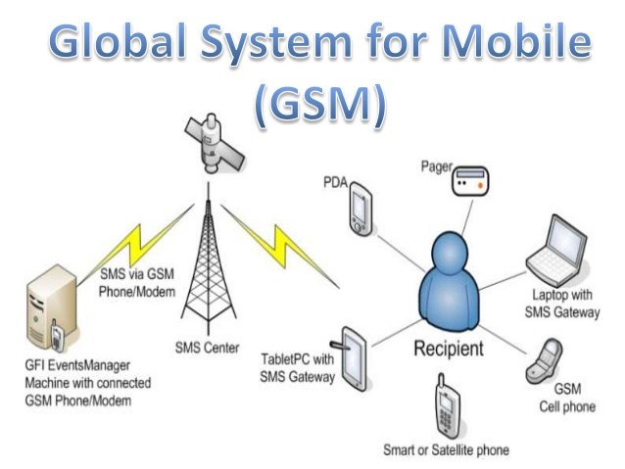
Module 3
GSM Module:
NAME: REGISTER NO.: PAGE NO: 08
SRR/CSE/MINI PROJECT/REVIEW2

Slide 17
Application
This system can be used in the four wheelers and more vehicles to prevent the accident.
This model can also used in the two wheelers prevent detect the accident.
The registered mobile person can reach the accidented person easily by the SMS system
The ambulance can reach the location easily with the help of the GPS location.
Many life can be saved by reducing the recovery time by the SMS system.
NAME: REGISTER NO.: PAGE O: 08
SRR/CSE/MINI PROJECT/REVIEW2

Slide 18
Conclusion and Future Enhacement
Thus we are concluded that our model will reduce the time to recover of the accident person and also enable the relative to know about the accident .
This model will enable us help in any time of the accident and save our life for our dependies.
The future scope is that the accident will be reduced and many lives be saved .
Many peoples can be given with the second chance to live their lives properly and securely.
NAME: REGISTER NO.: PAGE NO: 08
SRR/CSE/MINI PROJECT/REVIEW2

Slide 19
REFERENCES
[1] Mr.S.Iyyappan ,V.Nandagopal “Accident detection and ambulance rescue with intelligent traffic light system” International Journal of advanced Research in EEIE-2013.
[2] K.Sangeetha, P.Archana, M.Ramya , P.Ramya “Automatic Ambulance Rescue with Intelligent Traffic Light System” International organization of scientific Research journal of Engineering-2014
[3] Mr. Sahil Gadroo Mr. Pinkesh Jodhwani Mr. Gunveer Singh Mr. A. D. Londhe “Automatic accident detection and ambulance rescue system” International journal of scientific &engineering research-2015
[4] Hrishikesh Murkut, Fazal Patil, Vishal Yadav, Meghana Deshpande “Automatic accident detection and rescue with ambulance”SSRG International journal of ECE-2015
[5] A. Hac, "Wireless Sensor Network Designs”, John Wiley& Sons,Ltd, 2003.
[6] M. Kuorilehto, M. Kohvakka, J. Suhonen, P. Hamalainen, M.Hannikainen, and T. Hamalainen, "Ultra-Low Energy Wireless Sensor Networks in Practice Theory", Realization and Deployment, John Wiley & Sons, Inc, 2007.
[7] N. Bulusu, "Wireless Sensor Networks", Artech House, Inc, 2005.
[8] M. Lee, C. Yao, H. Liu,” Passive Tag for Multi-carrier RFID Systems”, IEEE 17th International Conference on Parallel and Distributed Systems, 2011.
[9] Y. Khalil, M. Al-kariki, “Intelligent Traffic Light Flow Control System using Wireless Sensor Networks”, Journal of Information Science and Engineering, 26, 753-768 (2010) .
[10] R. Kannan , R. Nammily, S. Manoj , A. Vishwa, ” Wireless Vehicular Accident Detection and Reporting System”, International Conference on Mechanical and Electrical Technology (ICMET 2010).
NAME: REGISTER NO.: PAGE NO: 08
SRR/CSE/MINI PROJECT/REVIEW2
NAME:JANANI.JA REGISTER NO.: 312014104037 PAGE NO: 23 SRR/CSE/ CONTEST 2K17
NAME:JANANI.JA REGISTER NO.: 312014104037 PAGE NO: 24 SRR/CSE/ CONTEST 2K17
NAME: REGISTER NO: PAGE NO: NAME: REGISTER NO.: PAGE NO: 08
SRR/CSE/MINI PROJECT/REVIEW2
NAME: REGISTER NO.: PAGE NO: 08
SRR/CSE/MINI PROJECT/REVIEW2

Slide 20
THANK YOU
NAME:JANANI.JA REGISTER NO.: 312014104037 PAGE NO: 24 SRR/CSE/ CONTEST 2K17
NAME: REGISTER NO: PAGE NO: NAME: REGISTER NO.: PAGE NO: 08
SRR/CSE/MINI PROJECT/REVIEW2
NAME: REGISTER NO.: PAGE NO: 08
SRR/CSE/MINI PROJECT/REVIEW2

